Slide 1




Bank Marketing Campaign
Opening a Term Deposit
INTAN TJENDERA | M NAUFAL REFADI

Slide 2
A little bit of
background…

Slide 3

WHAT IS A
Term Deposit?
Key Takeaways:
A type of deposit account held at a financial institution where money is locked up for a set period of time.
Offers higher interest rates than traditional liquid savings accounts, whereby customers can withdraw their money at any time.
Source:
https://www.investopedia.com/terms/t/termdeposit.asp
Bank Marketing Campaign

Slide 4

In essence...
By allowing banks to hold onto a deposit for a specific amount of time, they can invest in higher gain financial products in order to make a profit.
They can also hold a better chance to persuade term deposit clients into buying other products such as funds or insurance to further increase their revenues.

Slide 5
Problem Statement
& Goals

Slide 6


Problem Statement
Objectives
Identify target customers with higher conversion rate
Minimize marketing costs by mainly focusing on target customers
Appropriate funds and labor allocations
Portugal Bank sees a potential decline in revenue as clients are not depositing into the bank as frequently as before

Slide 7

APPROACH
Create machine learning (ML) algorithm to achieve efficient marketing and also give an insight to banks how effective direct phone call campaigns are, as compared to other sales channels; and vice versa
Evaluation method: Accuracy, Precision, Recall, F1-score
Focus on Recall scores
Risks include overestimation of target customer behavior despite customer having all aspects of being a 'potential client'
Supervised,
Classification
Problem

Slide 8
Data Understanding
& Data Cleaning

Slide 9

Data Collection
Data Source:
https://www.kaggle.com/volodymyrgavrysh/bank-marketing-campaigns-dataset
Data Description:
A dataset that describes the Portugal bank's marketing campaigns results.
Conducted campaigns were based mostly on direct phone calls, offering bank clients to place a term deposit.
Number of Columns:
20 + output variable
Number of Rows:
41188
Bank Marketing Campaign

Slide 10


Data Understanding
age : client's age
job : type of job
marital : marital status
education : last education
default: has credit in default?
housing: has housing loan?
loan: has personal loan?
contact: contact communication type
month: last contact month of year
dayofweek: last contact day of the week
duration: last contact duration, in seconds.
campaign: number of contacts performed during this campaign and for this client
pdays: number of days that passed by after the client was last contacted from a previous campaign
previous: number of contacts performed before this campaign and for this client
poutcome: outcome of the previous marketing campaign
emp.var.rate: employment variation rate - quarterly indicator
cons.price.idx: consumer price index - monthly indicator
cons.conf.idx: consumer confidence index - monthly indicator
euribor3m: euribor 3 month rate - daily indicator
nr.employed:number of employees - quarterly indicator
y : has the client subscribed a term deposit?
Bank Marketing Campaign

Slide 11

Check and drop columns with multiple null values
Check and drop columns with duplicated data (There is no null Values)
DataFrame shape BEFORE null and duplicate check:
(41188 , 21)
DataFrame shape AFTER null and duplicate check:
(41176 , 21)

Slide 12

Data Grouping
'education' column
Categories 'basic.4y', 'basic.6y', 'basic.9y' are grouped together under 'Basic'
'age' column
BANK MARKETING CAMPAIGN
Ages of the customers are grouped into 4 classes:
17-29 = Young
30-43 = Middle-age Adult
44-56 = Old-age Adult
56-100 = Elderly
'pdays' column
Updated into binary numerical feature:
'0' for '999' / no previous contact with clients
'1' for previous contact made / other values aside '999'

Slide 13
Exploratory Data
Analysis

Slide 14
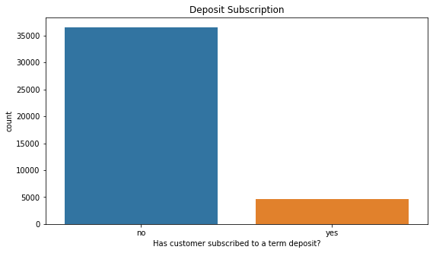
Distribution of Target Variable
From the graph, the success/conversion rate for term depositors without a ML model is about 11 out of every 100 calls (~11%).

Slide 15
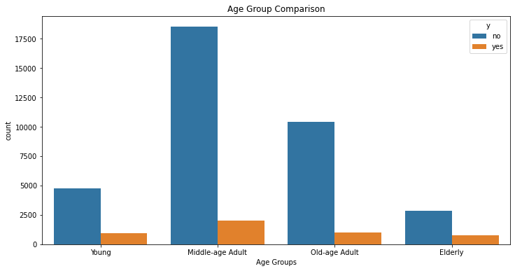
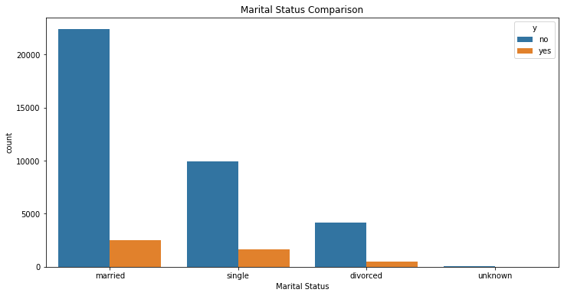
Target Variable Distribution Based On Other Features
Success Rate
based on Age and Marital Status

Slide 16
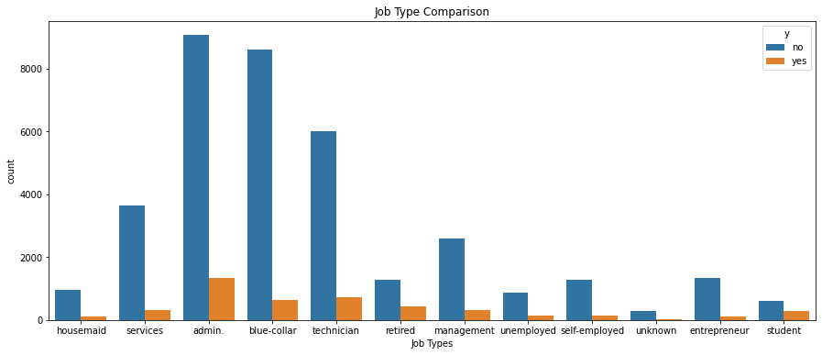
'student' (31.43%) or 'retired' (25.23%) are more likely to make a term deposit.
Least likely to make a term deposit are 'blue-collared' clients (6.89%).

Slide 17
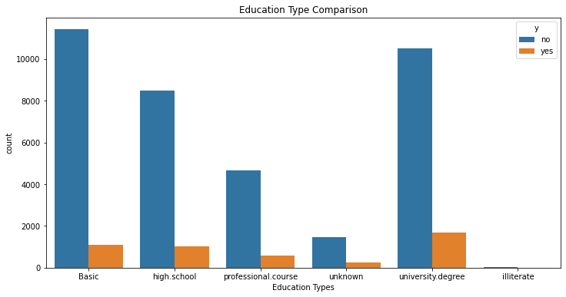
Aside from clients who are 'illiterate' or whose education background is 'unknown', those with 'university degree' have the next highest conversion rate

Slide 18
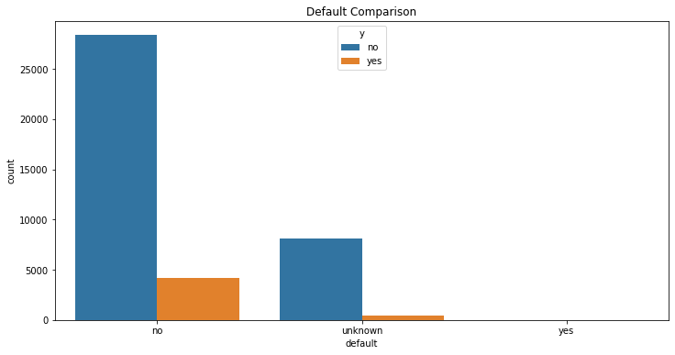
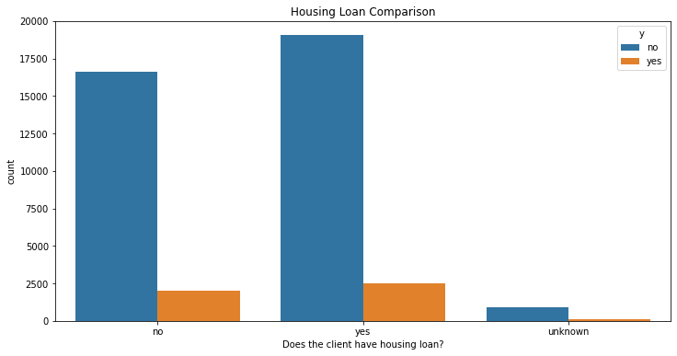
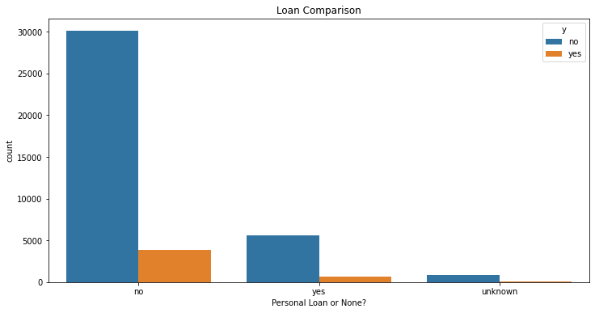

Success Rate based on Credit, Housing or Personal Loan Possession

Slide 19
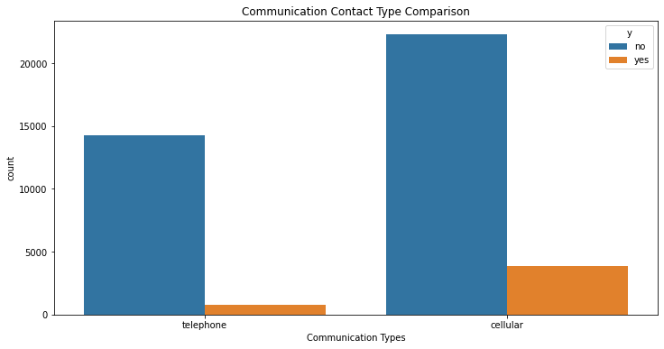


Success rate relatively higher for marketing via cellular means

Slide 20
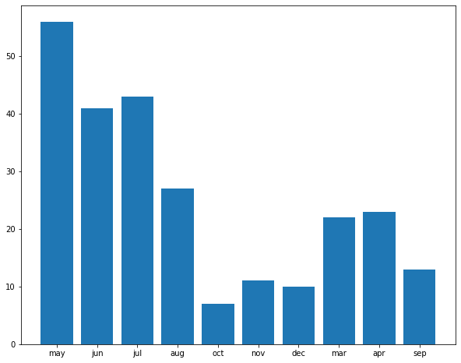
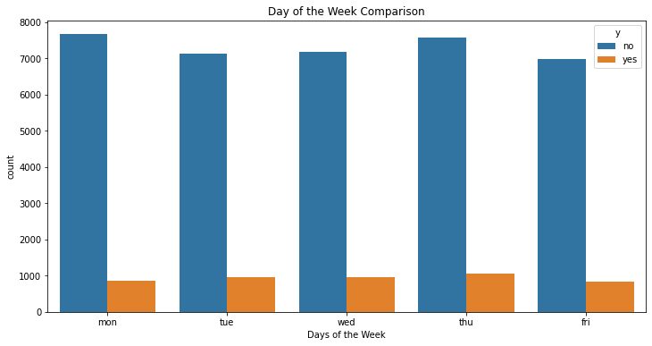
Clients are mostly contacted during May - July period; Jan and Feb details are missing
Conversion rate highest for Sept, Oct and Dec
Equal success rate regardless of the day of the week
Campaign only carried out during weekdays
Success Rate based on
Day of the Week
Month vs Campaign

Slide 21
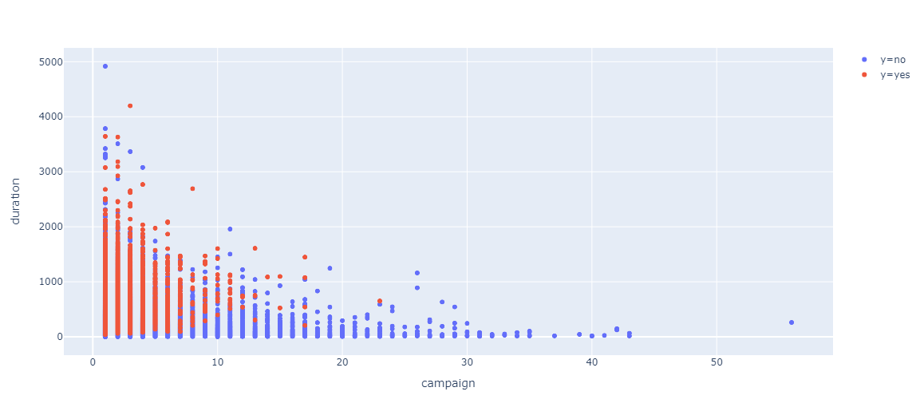
Campaign vs Duration

Slide 22
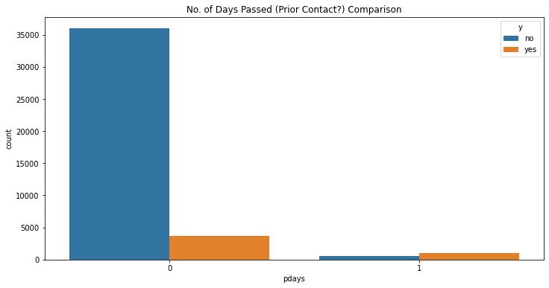
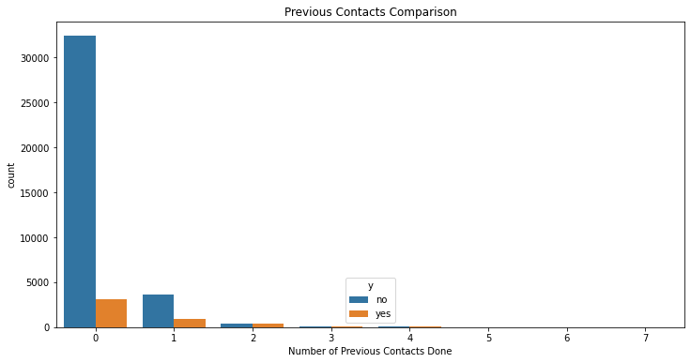
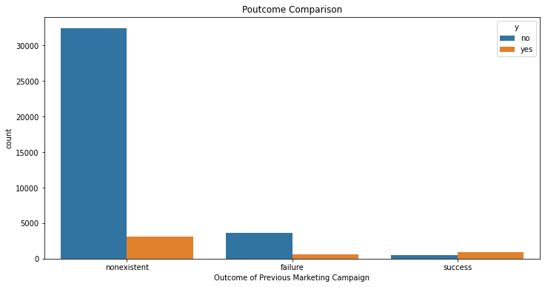
Customer conversion rate higher for those that had previous contact (~5x max) and were a success in a previous marketing campaign

Slide 23
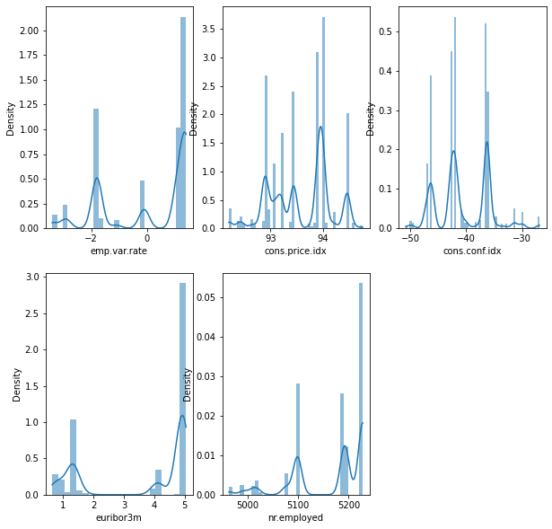
Socio-Economic Attributes Distribution
Campaign possibly made during high employee variation rate
High consumer price index may be a stimulant for clients to make a deposit (idea of savings)
Low consumer confidence index due to fluctuating economy?
Relatively high 3 months Euribor interest rate
Increase in number of employees result in higher income index , which may be a target factor for campaign to get employed clients to make a term deposit

Slide 24
ML Modelling

Slide 25
Feature Selection
Decide whether or not to drop speicifc features
Term Depositors Predictor Modelling Steps
Encoding
Scaling numerical columns
OneHot and Binary encode categorical features
Model Training & Selection
Cross Validation
Select best model
Model Tuning & Evaluation
Confusion Matrix
ROC - AUC Score
Feature Importance

Slide 26
Feature Selection
Two Approaches
Dropped:
'age'
'marital'
'education'
'housing'
'duration'
'dayofweek'
'loan'
No features dropped aside from 'age' and 'duration'
'duration' is dropped for both approaches in order to achieve a more realistic model
'age' dropped since new categorical column 'agegroup' made

Slide 27



Encoding
1
2
3
NUMERICAL ENCODING
CATEGORICAL ENCODING
BINARY
ENCODING
StandardScaler
OneHotEncoder
BinaryEncoder
The following encoding are applied to both approaches.

Slide 28

Encoding
Technique used to
alleviate imbalanced data
Split Train &
Test Sets
Random
OverSampling

Slide 29



1. Logistic Regression
2. K-Nearest Neighbor
Model Training
3. Random Forest
4. Gradient Boosting
BANK MARKETING CAMPAIGN

Slide 30
Model Training
with dropped feature
Train Accuracy
Test Accuracy
Precision
Recall
F1-Score
Logistic Regression
0.797990
0.797950
0.742661
0.448324
0.558977
K-Nearest Neighbor
0.869314
0.821157
0.676585
0.715644
0.695290
Random Forest
0.925812
0.879209
0.786622
0.792008
0.789071
Gradient Boosting
0.816492
0.815154
0.744136
0.538175
0.624532

Slide 31
Model Training
without dropped feature
Train Accuracy
Test Accuracy
Precision
Recall
F1-Score
Logistic Regression
0.800167
0.799561
0.740782
0.459260
0.566880
K-Nearest Neighbor
0.891895
0.824622
0.666257
0.772188
0.715096
Random
Forest
0.984986
0.939507
0.854782
0.949591
0.899427
Gradient
Boosting
0.815949
0.813543
0.740438
0.534934
0.621024

Slide 32
Train Accuracy
Test Accuracy
Precision
Recall
F1-Score
Random
Forest Without Drop
0.984986
0.939507
0.854782
0.949591
0.899427
Random Forest With Drop
0.925812
0.879209
0.786622
0.792008
0.789071
Best model from the two approaches obtained = Random Forest
Recall scores compared
Final model selected = Random forest without any dropped features

Slide 33
Hyperparameter Tuning
& Evaluation

Slide 34

Find Optimum Parameter
for Model
Final Model Selection
Tuning with
RandomizedSearchCV
Decrease the execution time needed to compile
Chances to find an optimized parameter comparatively higher as it tests all patterns randomly under the assumption that not all hyperparameters are equally important
Reduces chance for overfitting to occur, despite potentially high variance due to being random

Slide 35

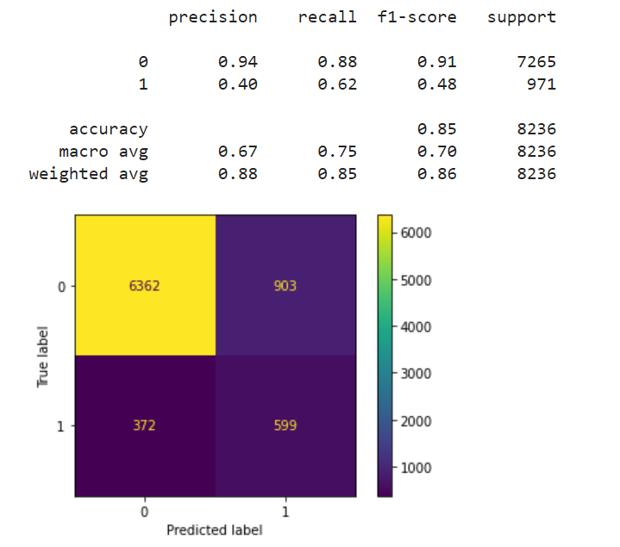

Confusion Matrix Plot
For better understanding, assume:
Call cost = $1
Profit from conversion = $10
Revenue = $9
Total Revenue w/o Model Use = $1,474
With Model Usage:
Additional profit of $3,720 from 372 FN clients
Additional revenue of ~$3,300 = ~2x initial revenue
Avoid additional loss of $1,491 from FP and TN clients

Slide 36

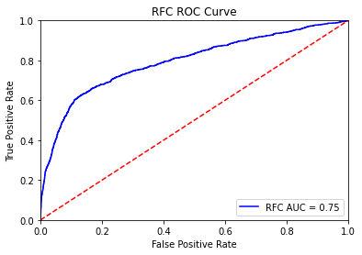


ROC - AUC Score
AUC = 0.75
There is a 75% chance that the model will be able to distinguish between positive class and negative class

Slide 37


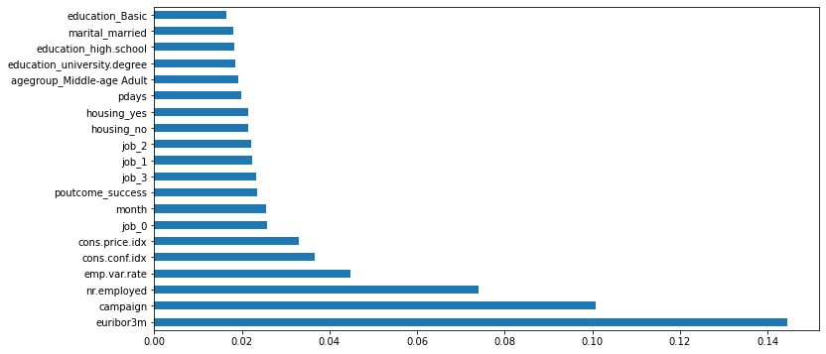
Feature Importance

Slide 38
Conclusion &
Recommendation

Slide 39

To conclude...
Random Forest is the best go-to prediction model
Model can be utilised to help the bank's call center to prioritize the call for potential clients and maximize the conversion rate - all while managing minimum cost on marketing.
As mentioned in evaluation...
Using the model can:
Acquire previously falsely identified potential clients
Bring additional revenue of approximately ~$3,300 while maintaining conversion rate quality
Avoid spending an additional marketing cost of $1,491 for falsely predicted clients
Generate about 2x more revenue to the bank

Slide 40


Improvements
Addressing the low precision and f1-scores
Implementing some more advanced techniques such as dimensionality reduction, ensemble learning and deep learning may contribute to the model's performance
Leveling the imbalanced data (e.g. there were less data on clients who agreed to make a term deposit) to improve its overall performance further

Slide 41


Recommendations
Making 'Job' specification a mandatory column for clients to fill in
Tune the campaign according to the national econometrics
Always contact clients by cellphone when possible
Creating a loyalty program for existing clients by giving them some bonuses and unique offers. Data shows that loyal clients, or clients with frequent past contacts are more likely to buy products/have higher conversion rate in making a term deposit

Slide 42


